Slide 1


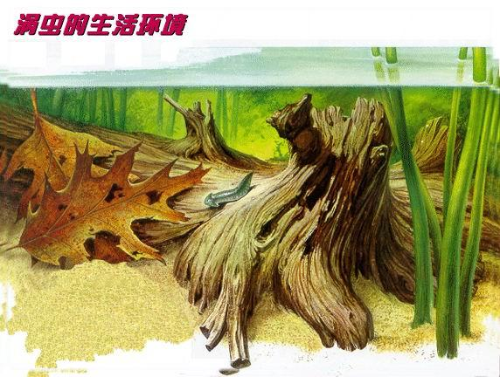
Chapter 8.
Acoelomate triploblastic animals: Platyhelminthes

Slide 2
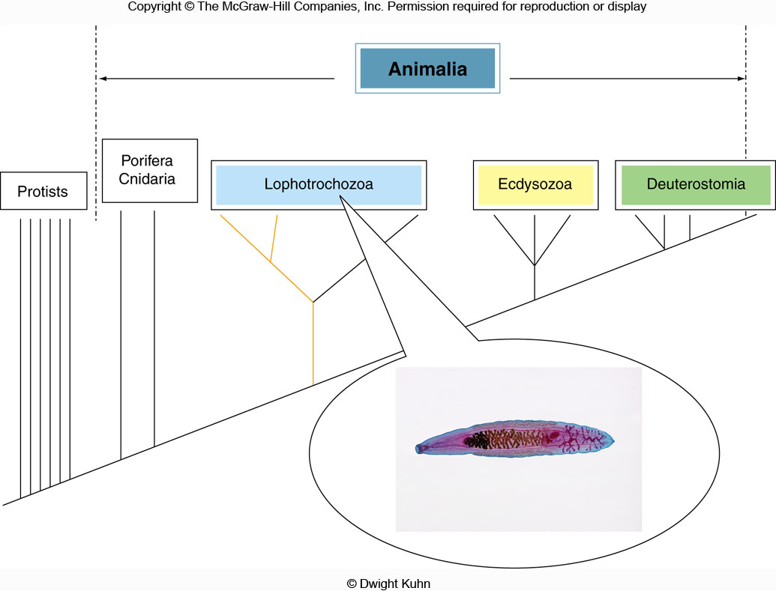
= Metazoa
Protostomia
+
Phylogenetic position of Platyhelminthes
Lophotrochozoa: trochozoans ( Nemertea, Mollusca, Sipuncula, and Annelida)
and lophophorata (Bryozoa, Entoprocta, Phoronida, and Brachiopoda);
Ecdysozoa: Arthropoda (insects, chelicerata, crustaceans, and myriapods), Nematoda;
Deuterostomia: Chordata (vertebrates and their kin), Echinodermata (sea stars, sea urchins,
sea cucumbers,) and Hemichordata (acorn worms).

Slide 3
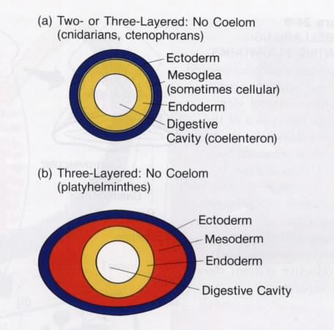
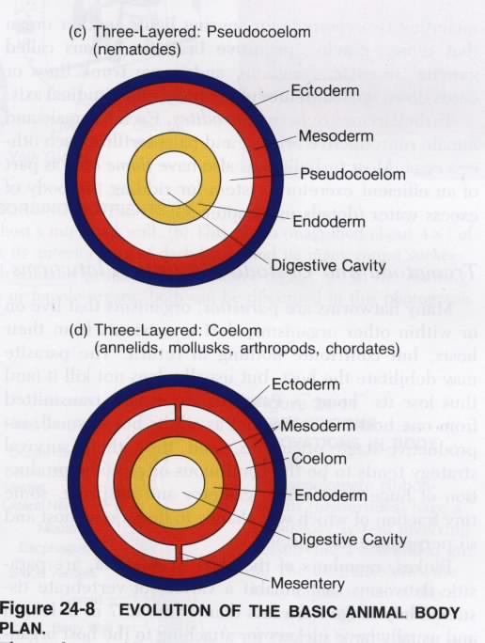
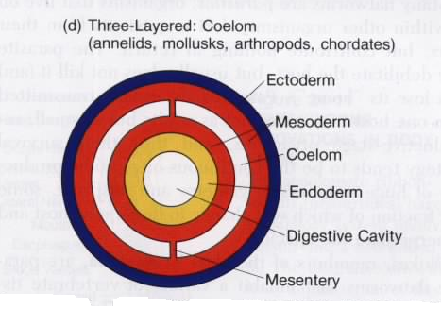
Diploblastic
Triploblastic, acoelomate: 无体腔动物
Triploblastic, Pseudocoelomate: 假体腔动物
Triploblastic, Coelomate: 真体腔动物
Acoelomate: Platyhelminthes and Nemertea
Pseudocoelomate: Nematoda, Rotifera
Coelomate: Molluscus, Arthropoda, and Chordata

Slide 4
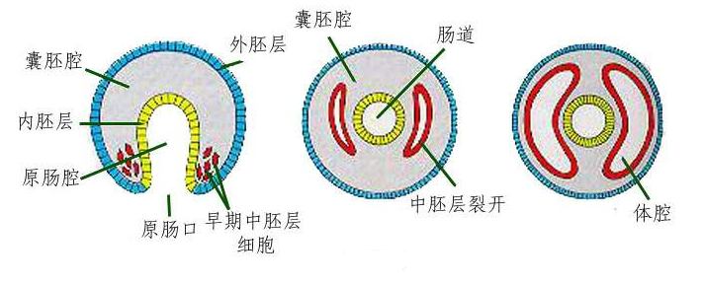
Formation of mesoderm
Schizocoelous method 裂体腔法

Slide 5
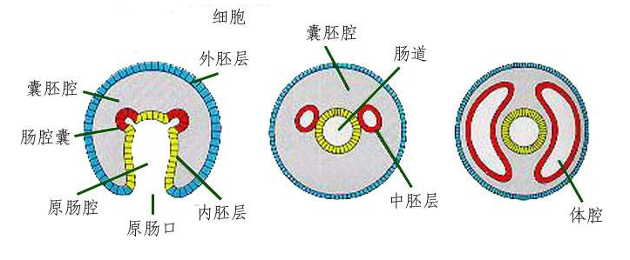
Coelesac method 体腔囊法

Slide 6
OUTLINE
8.1 Phylum Platyhelminthes: flatworms
8.2 Phylum Acoelomorpha 无腔动物
8.3 Phylum Nemertea 纽形动物
8.4 Phylum Gastrotricha腹毛动物
8.5 Phylum Cycliophora 环口动物
Key Points: 1) Evolutionary significance of triploblasty and bilateria
2) Adaptive traits of flatworms with parasitic lifestyle

Slide 7
OUTLINE
8.1 Phylum Platyhelminthes: flatworms
8.2 Phylum Acoelomorpha 无腔动物
8.3 PhylumNemertea 纽形动物
8.4 Phylum Gastrotricha腹毛动物
8.5 Phylum Cycliophora 环口动物

Slide 8
1. General Characteristics
(1) Bilaterally symmetrical body plan;
(2) Triploblasty: ectoderm, endoderm and mesoderm;
(3) Body wall with dermomuscular sac, Parenchyma (实质) between body wall and digestive cavity;
(4) Primitive organ systems: incomplete digestive system, ladder-like nervous system with a primitive brain, protonephridia(原肾管) excretory system, multiple sensory organs;
(5) Free-living and parasitic (Ectoparasites and Endoparasites) lifestyle.

Slide 9
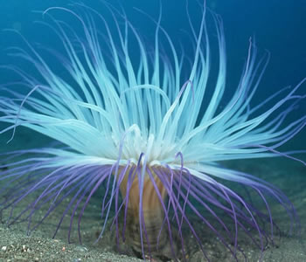
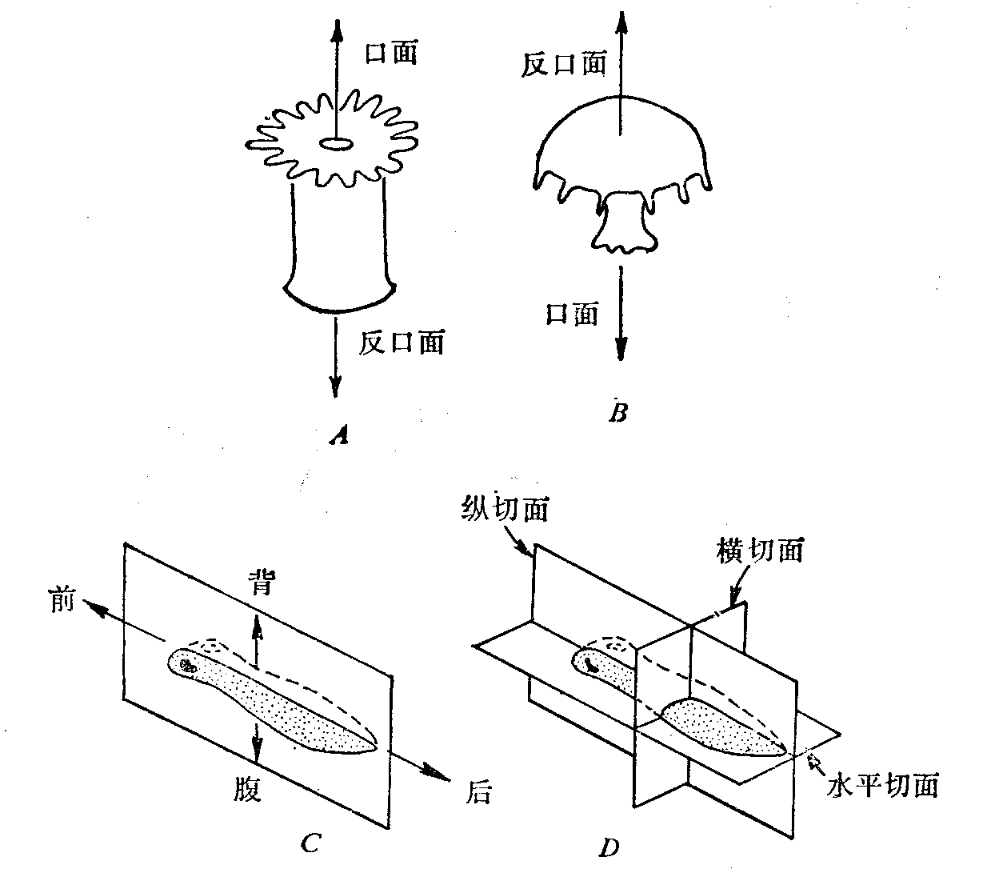
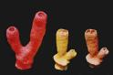
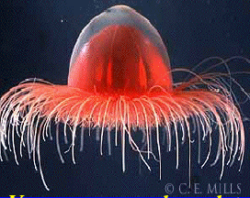
(1) Bilaterally symmetrical body plan
asymmetrical
radial
bilateral

Slide 10
Evolutionary significance
Resulting in differentiation of the structure and function of animal bodies: anterior / posterior, dorsal / ventral, left / right;
Oriented movement: sensory and nerve cells are cephalized;
Crawling at the bottom of water: a prerequisite for crawling on the land, advanced than floating

Slide 11
(2) Triploblasty (evolutionary significance)
Mesodermally derived Parenchyma实质 stores nutrients and water, and mesoderm lays a foundation for differentiation of organ systems;
Mesodermally derived muscles promote differentiation of tissues and organs, and facilitate locomotion ability (that is helpful for effectively feeding, enhanced metabolism, formation of digestive and excretive systems, and development of nervous system and sensory organs), which is a requirement for the first carnivorous animal group;
The occurrence of mesoderm is one of the basic requirements for transition from water to land.

Slide 12
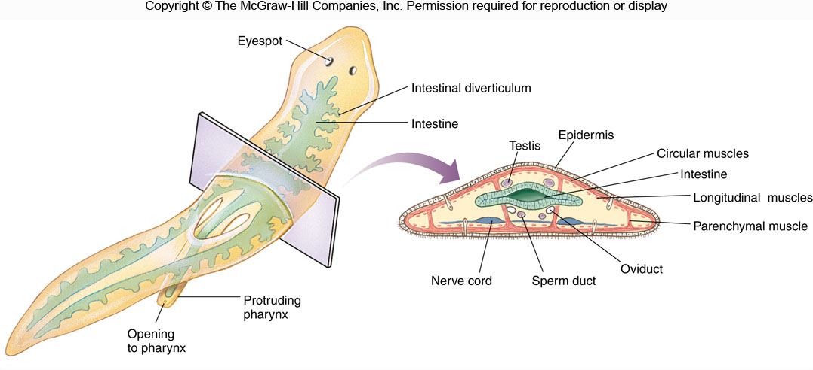
(3) Dermomuscular sac and parenchyma
Dermomuscular sac皮肌囊 includes ectodermally derived epidermis +
mesodermally derived muscles and enables protection and locomotion

Slide 13
Evolutionary signifcance of dermomuscular sac
Improvement of locomotion ability: enhancement of feeding effectiveness, intensification of metabolism, formation of digestive and excretive systems
Improvement of locomotion ability: development of sensory organs and nervous system

Slide 14
Parenchyma 实质
Location: between epidermis and gastrodermis;
Composition: synchytium cells 合胞体 and intercellular substances, including nutritious liquid;
Function: nutritive storage and slow material transport. (Parenchyma keeps flatworms alive temporarily even they leave off the water)

Slide 15
(4) Primitive organ systems
i) Incomplete digestive system
- an endodermally derived, blind-ending digestive cavity, with mouth but without anus
Pharynx — with strong muscles around the wall, vary in structure, telescopic to feed food
Digestive tract
• Absent in some marine turbellarians
• Tube-like or chamber-like, unbranched, 单肠类
• Branched, with a stem, 三肠类
• Extensively branched, with no stem, 多肠类

Slide 16
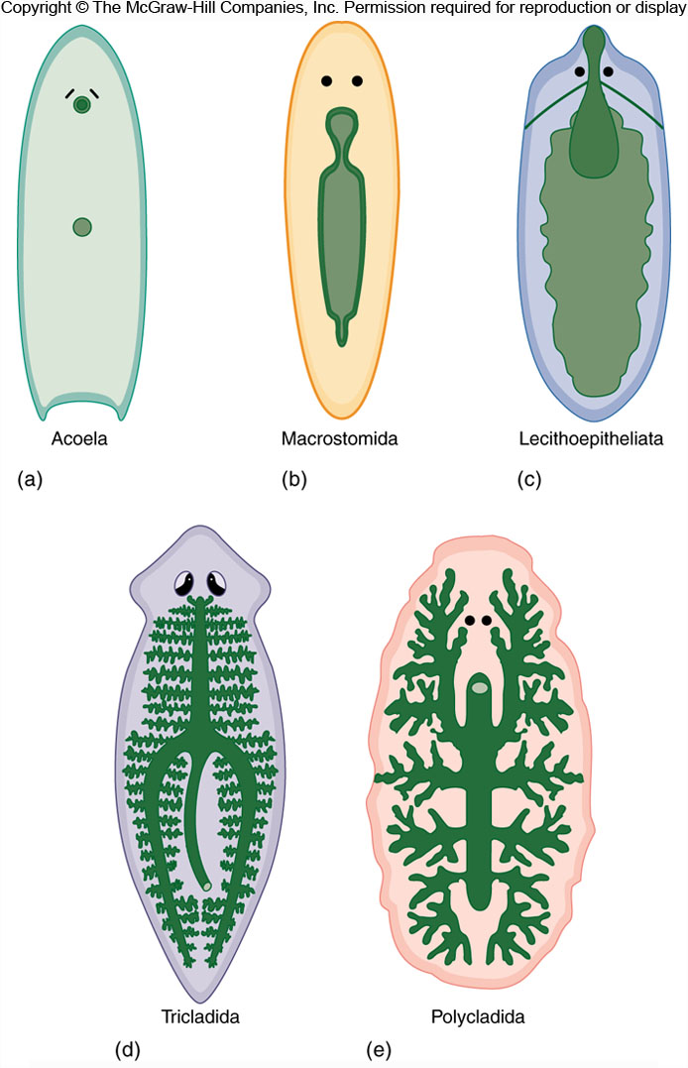
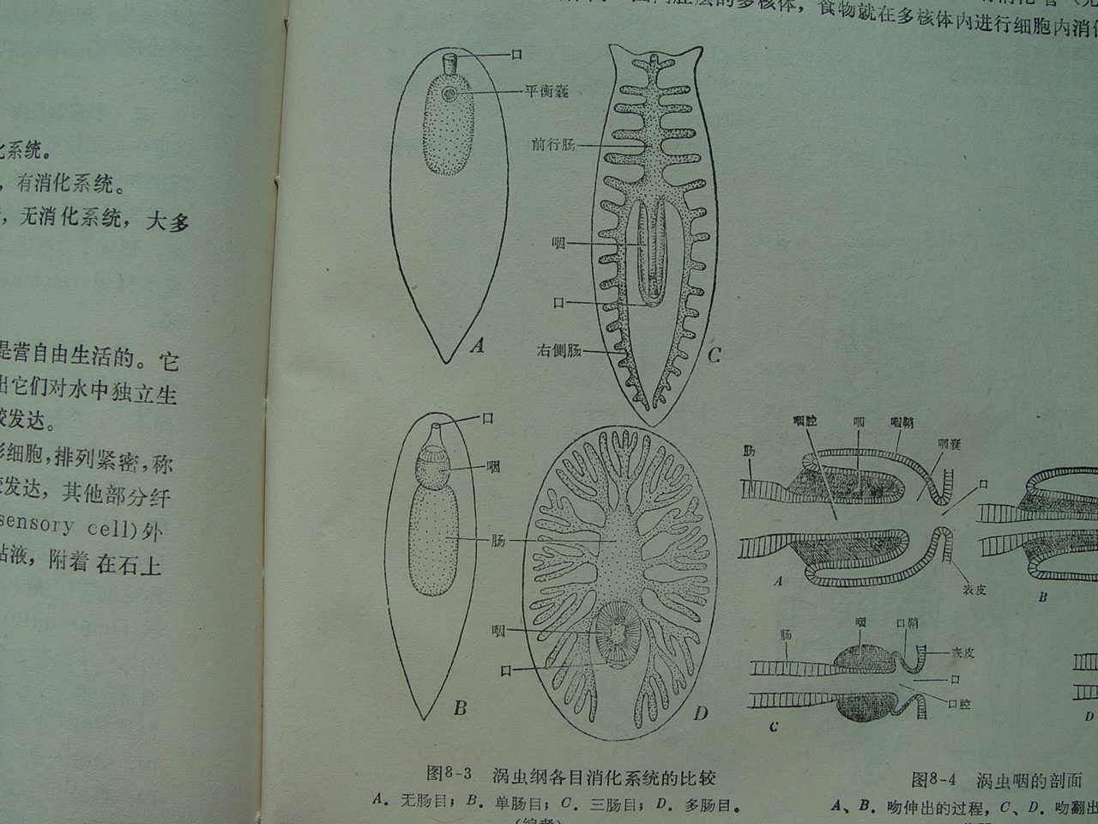
Types of digestive tract

Slide 17
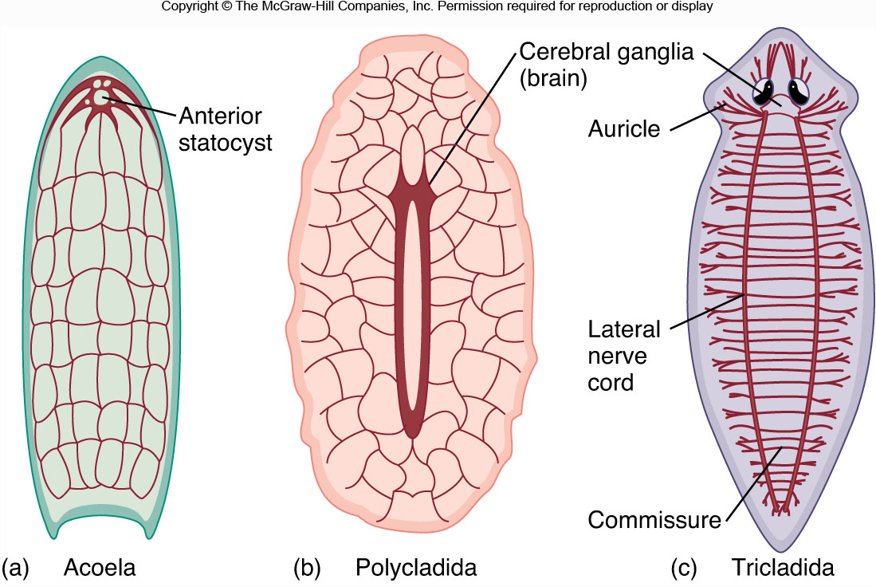
ii) Ladder-like nervous system with a primitive brain

Slide 18
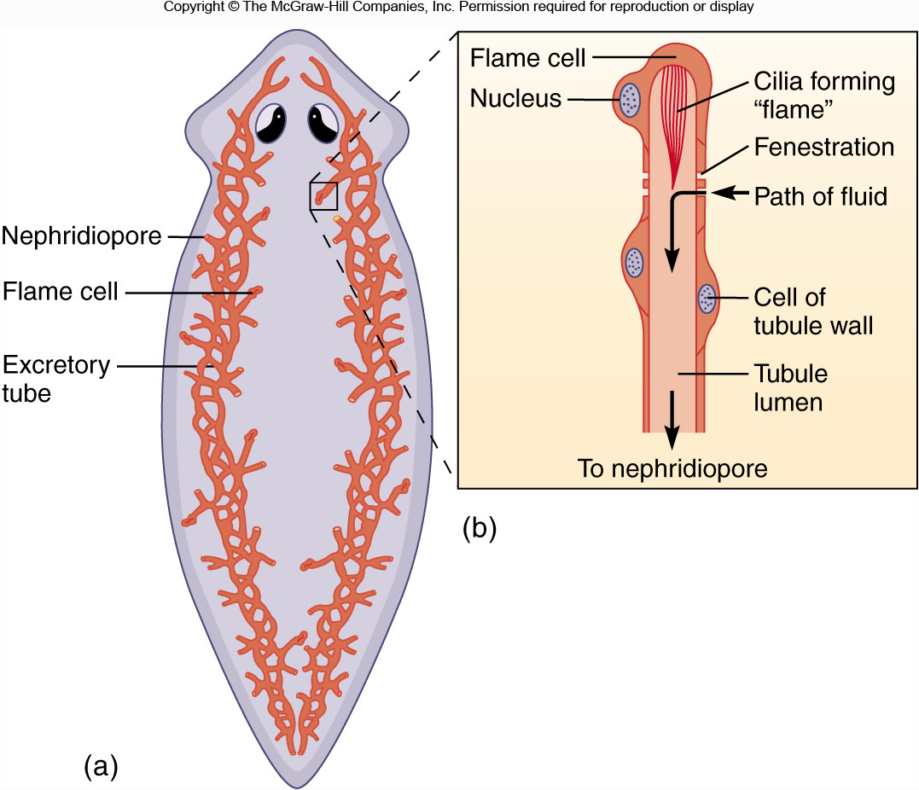
iii) Protonephridia(原肾管) excretory system

Slide 19
iv) Sensory organs
• Eyespot 眼点：a pair
⎯⎯ orient the animal to the direction of light
• Auricle 耳突：a pair, project from the side of the head
• Statocyst 平衡囊：near the cerebral ganglia
• Many sensory cells: distributed over the body
⎯⎯ to detect touch, water currents and chemicals

Slide 20
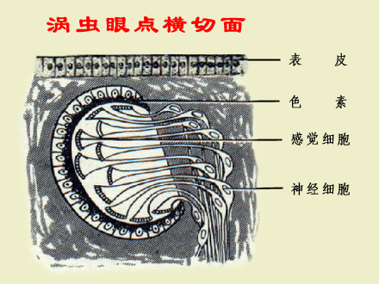
Eyespot: pigment cell 色素细胞 ＋ sensory cell 视觉细胞 — 感知光线明暗，但不能成像

Slide 21
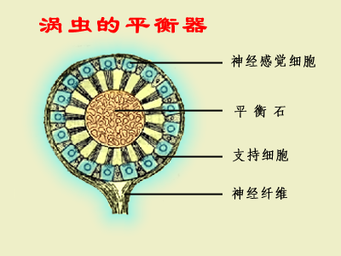

Slide 22
v) Reproduction and development
• Asexual reproduction
⎯⎯ transverse fission
• Sexual reproduction
most hermaphroditic 雌雄同体
cross-fertilization 异体受精, Internal fertilization
• Direct development: most turbellarians
• Indirect development
⎯⎯ Müller’s larva 牟勒氏幼虫, a free-swimming larva, a few turbellarians
One or more larval stages, at least two different hosts, flukes

Slide 23
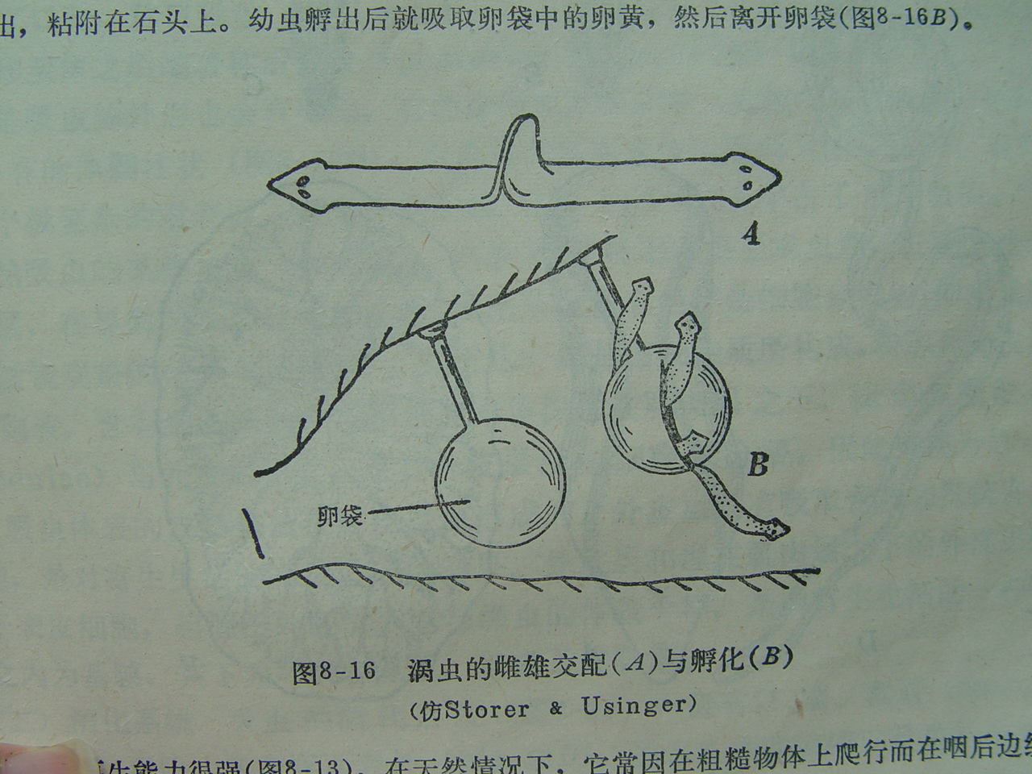
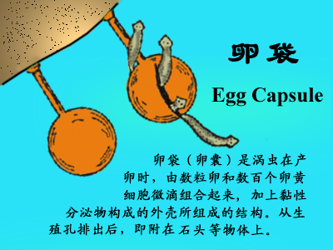
Pudendum 外生殖器
⎯⎯ make copulation and internal fertilization possible, providing a basis of animals shift from water to land

Slide 24
Reproductive systems arise from the mesodermal tissues and are complex in structure
⎯⎯ The first fixed reproductive glands and ducts among animal kingdom
• Male reproductive organ
testis (1-2 or more) + sperm duct + adjunctive structures (seminal vesicle etc.)
• Female reproductive organ
ovary (1-2 or more) + oviduct + adjunctive structures (yolk glands etc.)

Slide 25
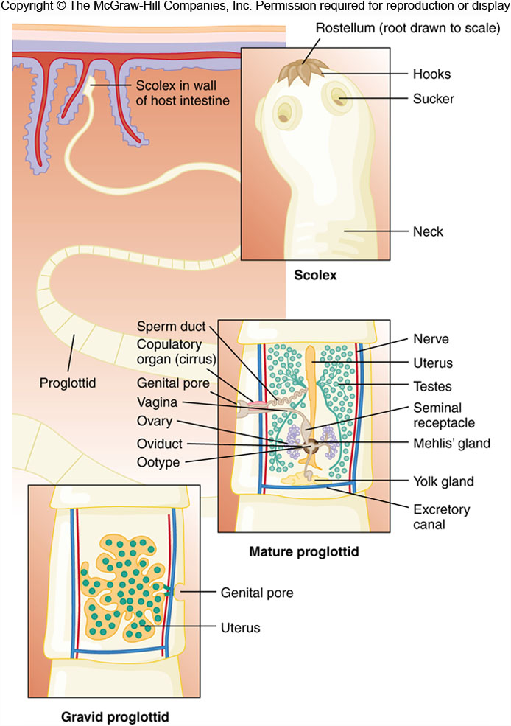
Reproductive systems of parasitic species are highly developed
In tapeworms绦虫
Adults consist of a long series of repeating units called proglottids 节片
⎯⎯ Each proglottid contains one or two complete sets of reproductive structures

Slide 26
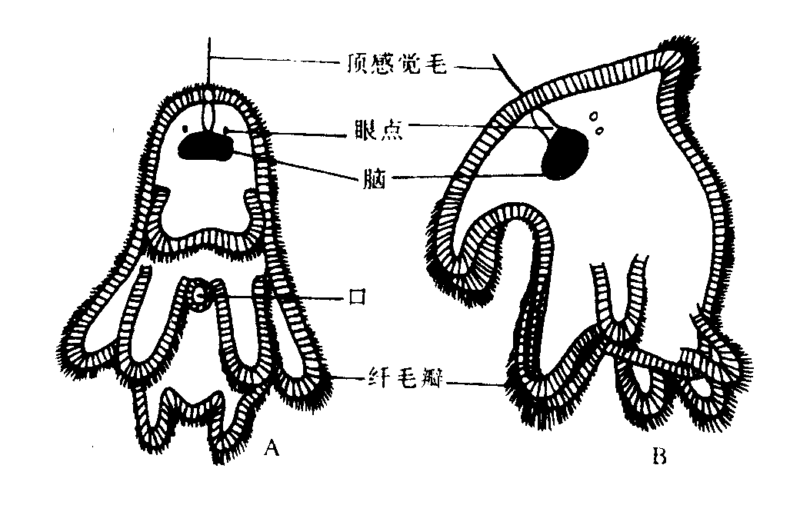
• Direct development: most turbellarians
• Indirect development:
⎯ Müller’s larva 牟勒氏幼虫
⎯⎯ a free-swimming larva, a few turbellarians
⎯ One or more larval stages, in at least two different hosts, flukes, tapeworms

Slide 27
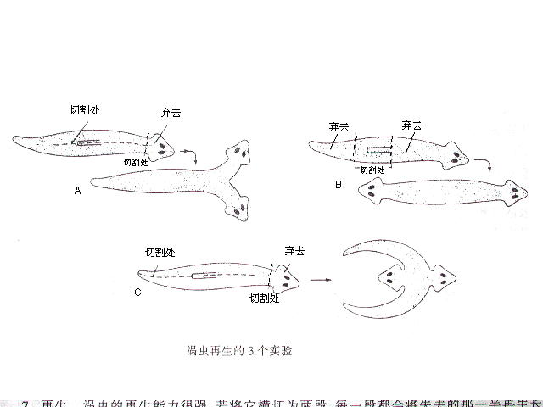
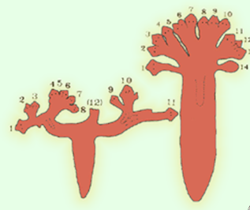

Slide 28
Lifestyle
• Free-living: class Turbellria
Marine: most
Freshwater and moist soil: a few
Predators, scavengers食腐
• Parasite
Ectoparasites: Class Monogenea 单殖纲
Endoparasites: Classes Trematoda and Cestoidea
吸虫纲 绦虫纲

Slide 29
• Single host
⎯⎯ hatched larva parasite in the initial host
Ectoparasites
• Multiple hosts
⎯⎯ 2-3 hosts during the life history
Endoparasites
The host of larva: intermediate host
The host of adults: final host

Slide 30
为什么要更换宿主？
1.与宿主的进化有关：低等宿主在进化过程中总是先出现，随着高等生物的出现，寄生虫才可扩大其寄主范围；
2.对寄生生活方式的一种适应：寄生虫对寄主总是有害的，若虫体繁殖过多导致寄主死亡，其自身也必然死亡。因此，寄生虫更换宿主使后代分布在更多的寄主体内，从而有更多的生存机会。

Slide 31
2. Classification of Platyhelminthes
Over 20000 species
• Class Turbellaria 涡虫纲：over 3000 species
• Class Monogenea 单殖纲：about 1100 species
• Class Trematoda 吸虫纲: over 10000 species
• Class Cestoidea 绦虫纲：about 3500 species

Slide 32
Class Turbellaria 涡虫纲
• < 1 cm to 60 cm
• Free-living flatworms
• Ciliated
• Rhabdite 杆状体
• Protractible porboscis 可伸出的吻
• Mucous glands分泌粘液的腺体
• Mostly hermaphroditic雌雄同体
• Movement, depending on muscle and cilia
The former is more important than the latter
• Bottom dwellers, crawling on stones, sand, or vegetation

Slide 33
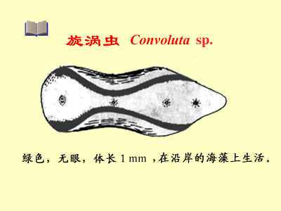
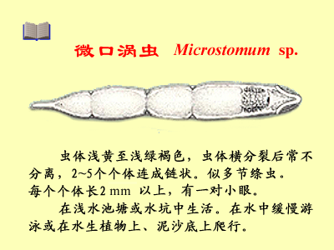
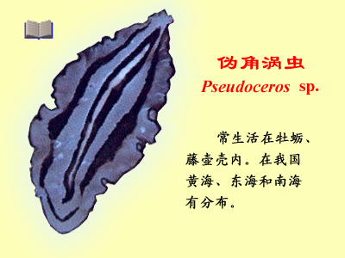
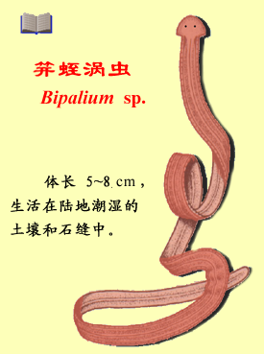
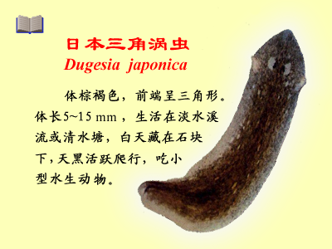

Slide 34
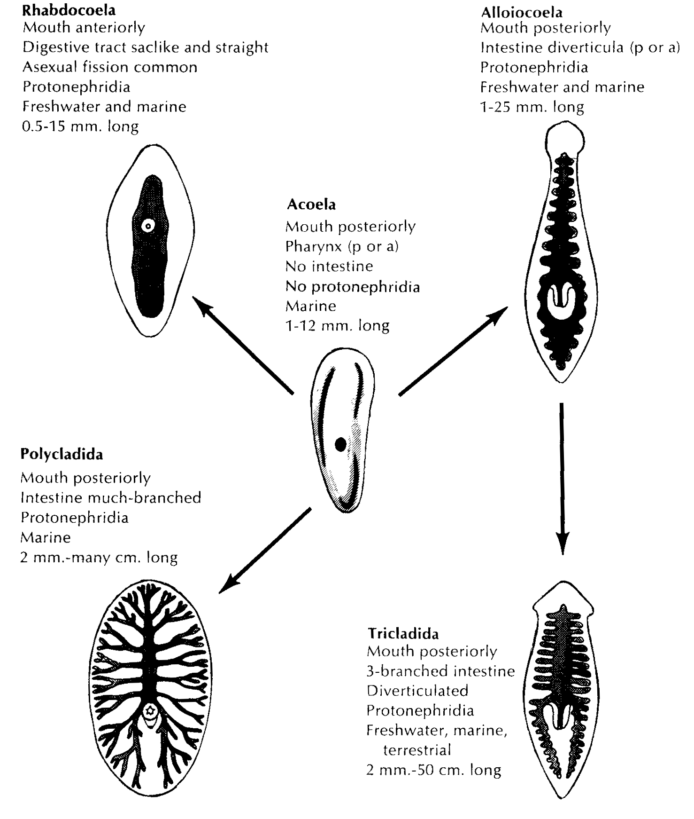
Debate for taxonomy
⎯⎯ 过去，一直根据消化管的有无及其复杂程度分为无肠目、单肠目、三肠目及多肠目
⎯⎯ 近年来，许多学者认为以生殖系统为主要依据并结合消化管的结构进行分类较为合理
单肠目

Slide 35
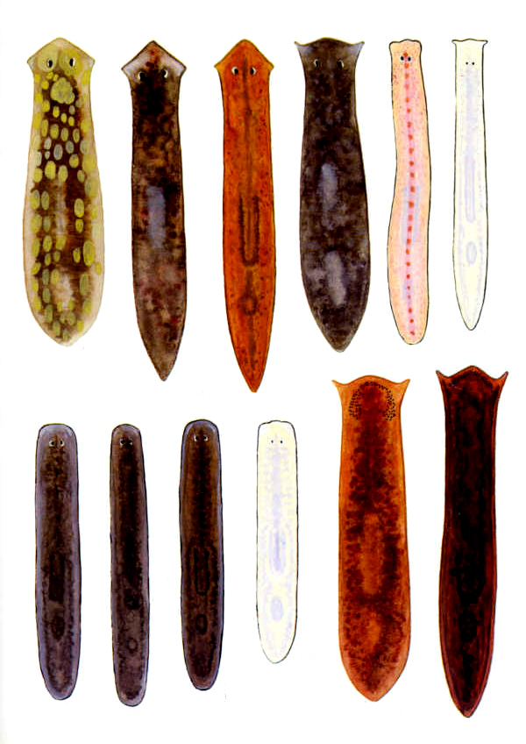
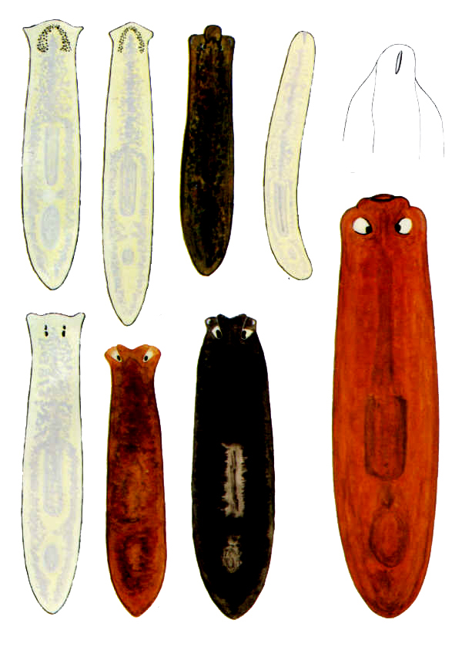

Slide 36
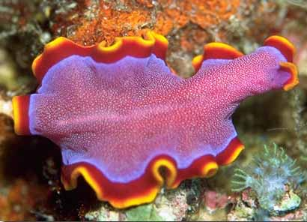
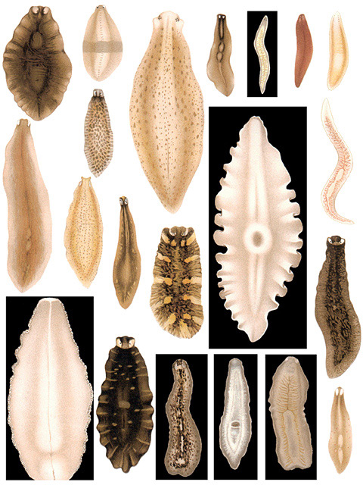
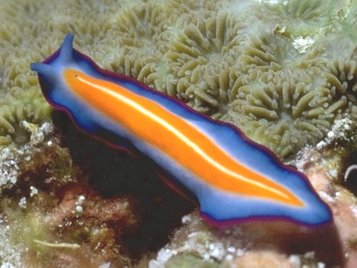
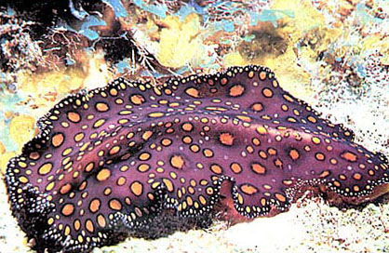

Slide 37
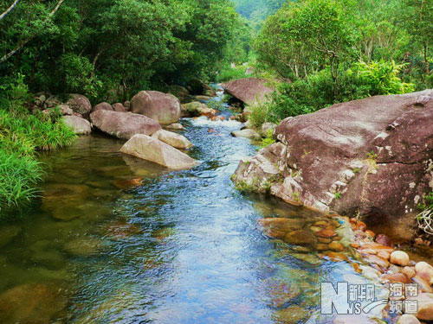
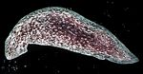
Freshwater turbellarians prefer to inhabit mountain streams feeding small animals In England, Dr. Reynoldson found that six specie he studied bred once a year Moreover, he described the reproductive patterns of 11 freshwater turbellarians 2 species: only asexual reproduction 7 speices: only sexual reproduction 2 species: both asexual and sexual reproduction

Slide 38
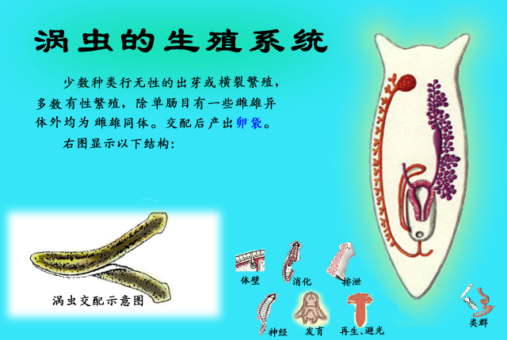
Fertilized eggs are enclosed in a hard capsule called a cocoon, which are expelled from the genital pore (卵茧）These coccons attached the substrate by a stalk（杆）

Slide 39
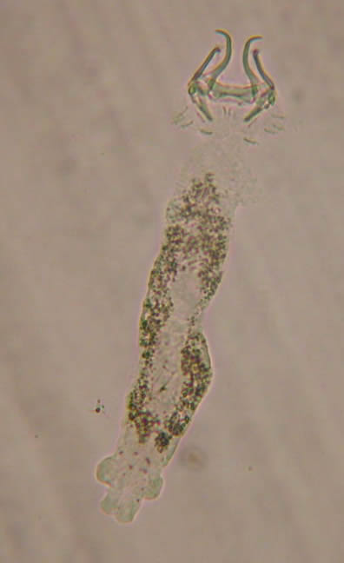
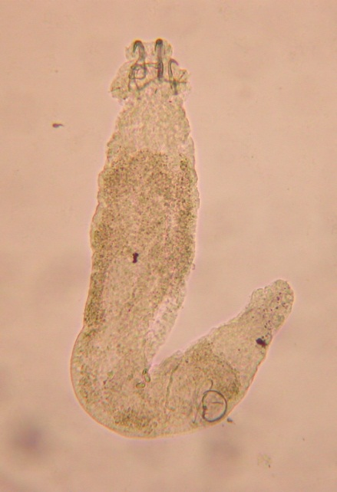
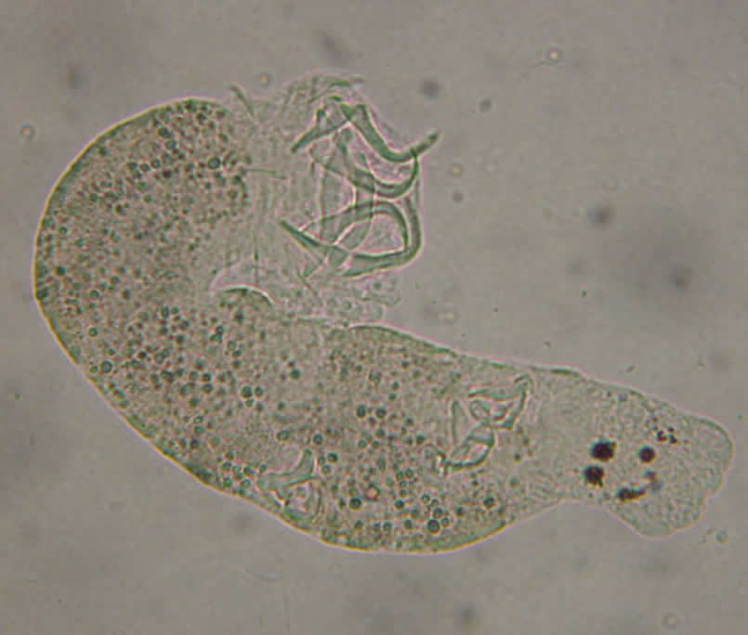
Class Monogenea 单殖纲
• 0.15-20 mm
• Mostly ectoparasites
• Single hosts, usually fishes
• Both prohaptor 前吸盘 and opisthaptor 后吸盘
• Hermaphroditic雌雄同体

Slide 40
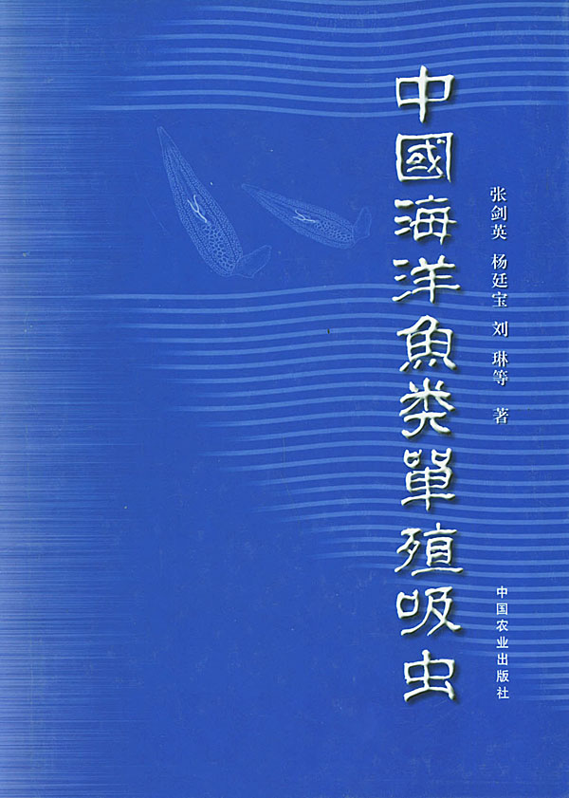

Slide 41
Class Trematoda 吸虫纲
1 mm to 6 cm
• All endoparasites
• Several holdfasts 附着器: 1-2
• Life cycle is complex, involving both asexual and sexual production, and two or more hosts
Subclass Aspidogastrea 盾腹亚纲
Mostly endoparasites in molluscs 软体动物
Subclass Digenea 复殖亚纲
Larva in invertebrates, adult in vertebrates
Fasciolopsis buski 布氏姜片虫 Fasciola hepatica 肝片吸虫

Slide 42
Digestive system Simple in structure mouth — pharynx — esophagus 食道 — two-branched intestine, blind-end, without anus Feeding on secretion of epithelial cells, blood cells and bile duct胆道 of hosts ⎯⎯ extracellular digestion Excretory system ⎯⎯ Protonephridial system原肾管

Slide 43
Reproductive system • Hermaphroditic雌雄同体 • Glands: complex in structure Male reproductive organs 精巢，输精小管，输精管，储精囊，生殖孔 Female reproductive organs 卵巢，劳氏管，卵黄腺，卵黄管，受精囊，成卵腔，梅氏腺，子宫，生殖孔

Slide 44
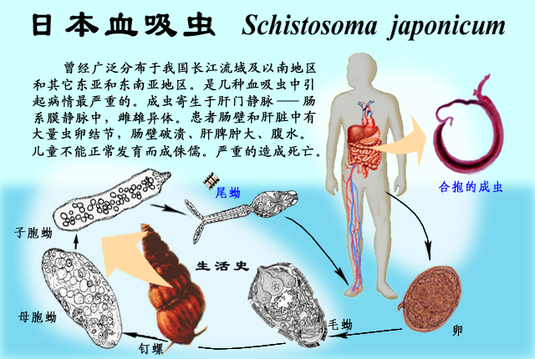
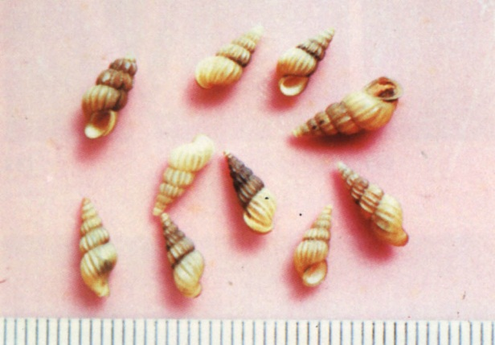
在人体内寄生的血吸虫主要有3种，即埃及血吸虫（S. haematobium）、曼氏血吸虫（S. mansoni）和日本血吸虫。在我国流行的是日本血吸虫，引起的疾病称为血吸虫病

Slide 45
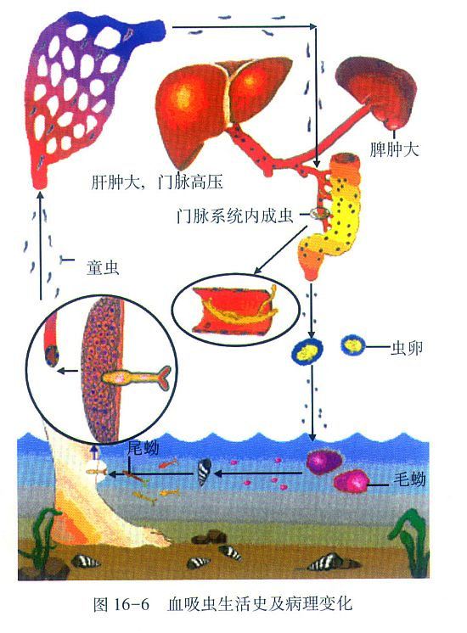
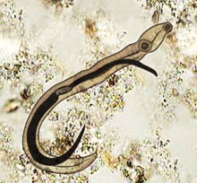
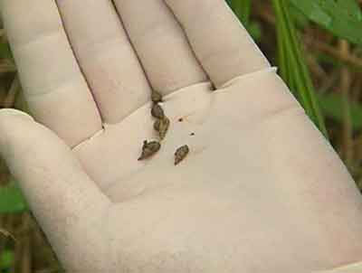

Slide 46
七律·送瘟神 1958.07.01，作者：毛泽东
读六月三十日《人民日报》，余江县消灭了血吸虫。浮想联翩，夜不能寐。微风拂晓，旭日临窗，遥望南天，欣然命笔。
其一
绿水青山枉自多，华佗无奈小虫何！
千村薜荔人遗矢，万户萧疏鬼唱歌。
坐地日行八万里，巡天遥看一千河。
牛郎欲问瘟神事，一样悲欢逐逝波。
其二
春风杨柳万千条，六亿神州尽舜尧。
红雨随心翻作浪，青山着意化为桥。
天连五岭银锄落，地动三河铁臂摇。
借问瘟君欲何往，纸船明烛照天烧

Slide 47
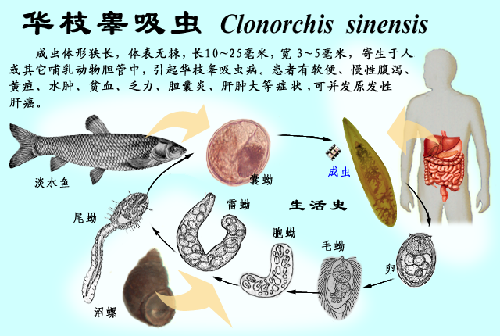
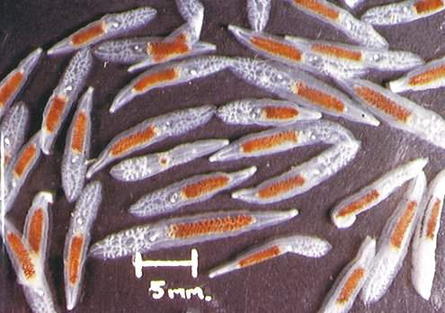

Slide 48


Slide 49
Class Cestoidea 绦虫纲
1 mm to 25 m
• All endoparasites
• Without digestive tract
• High reproductive potential
Subclass Cestodaria 单节亚纲
Not subdivided into proglottids
Larva in crustaceans, adult in fishes
Subclass Eucestoda 多节亚纲
Scolex, neck, and strobila that composed of many proglottids
Larva in invertebrates, adult in vertebrates

Slide 50


Slide 51


Slide 52

背囊幼虫
囊尾幼虫
节片
生殖孔

Slide 53

内寄生种类：更换宿主(why?)2~3个

Slide 54
Question: What are the adaptive characteristics of parasitic flatworms
Digestive system is dramatically reduced;
Nervous system and sensory organs are greatly reduced;
Characterized with hooks and suckers in order to bind to hosts;
Reproductive system is very powerful.

Slide 55
OUTLINE
8.1 Phylum Platyhelminthes: flatworms
8.2 Phylum Acoelomorpha 无腔动物
8.3 Phylum Nemertea 纽形动物
8.4 Phylum Gastrotricha腹毛动物
8.5 Phylum Cycliophora 环口动物

Slide 56

吻鞘
Acoelomorphs are
small flatworms
(<5mm long), do not
contain appendages附件.
Acoelomorphs resemble
flatworms in many respects,
but have a simpler anatomy,
even beyond the absence of
a gut. Like flatworms, they
have no circulatory
or respiratory systems,
but they also lack
an excretory system.
生殖孔

Slide 57
OUTLINE
8.1 Phylum Platyhelminthes: flatworms
8.2 Phylum Acoelomorpha 无腔动物
8.3 Phylum Nemertea 纽形动物
8.4 Phylum Gastrotricha腹毛动物
8.5 Phylum Cycliophora 环口动物

Slide 58

性腺
A nemertean is bilateral, triploblastic, acoelomate. But it contains complete digestive tract, cyclic system without heart, males and females are separate.
通管丝
吻鞘内腔
脑联合

Slide 59
OUTLINE
8.1 Phylum Platyhelminthes: flatworms
8.2 Phylum Acoelomorpha 无腔动物
8.3 Phylum Nemertea 纽形动物
8.4 Phylum Gastrotricha腹毛动物
8.5 Phylum Cycliophora 环口动物

Slide 60



Phylum Gastrotricha

Slide 61
OUTLINE
8.1 Phylum Platyhelminthes: flatworms
8.2 Phylum Acoelomorpha 无腔动物
8.3 Phylum Nemertea 纽形动物
8.4 Phylum Gastrotricha腹毛动物
8.5 Phylum Cycliophora 环口动物

Slide 62

A cycliophoran, was first discovered in 1995, a parasite of claw lobsters, very small (0.35mm long, and 0.10mm wide).

Slide 63

Life cycle of this new phylum

Slide 64
THANKS!

